Slide 1
WebAssembly: The Browser is your OS
@JeremyLikness
Microsoft

Slide 2


Slide 3

Jeremy Likness
Cloud Advocate @ Microsoft
Professional Developer for Quarter Century
👟 Likes to “run”
🥑 99.9765% plant-based diet
🎱 Shoots pool whenever possible
https://blog.jeremylikness.com/
@JeremyLikness
Jeremy.Likness@microsoft.com

Slide 5





JS

Slide 6

.NET
C#
Python
JS?
F#
Go
Java
Ruby
Rust

Slide 7
Let’s back up a second …

Slide 8
In the beginning …
const computePrime = () => {
var lastPrime = -1;
for (let i = 2; i < 50000; i+=1) {
let isPrime = true;
for (let j = i-1; j >= 2; j-=1) {
if (i % j == 0) {
isPrime = false;
break;
}
}
if (isPrime) {
lastPrime = i;
}
}
return lastPrime;
}

Slide 9
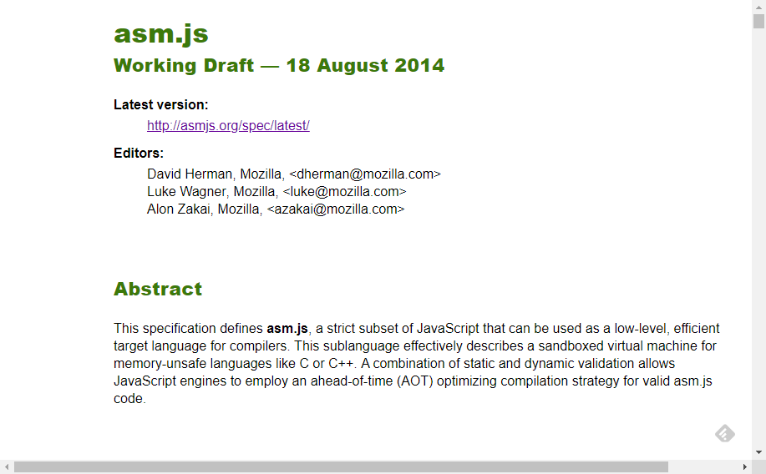
Along came asm.js …

Slide 10
Along came asm.js …
C/C++/Rust/Go/etc.

Slide 11
Along came asm.js …
C/C++/Rust/Go/etc.
Clang (or other)

Slide 12
Along came asm.js …
C/C++/Rust/Go/etc.
Clang (or other)
LLVM Bytecode

Slide 13
Along came asm.js …
C/C++/Rust/Go/etc.
Clang (or other)
LLVM Bytecode
Emscripten

Slide 14
Along came asm.js …
C/C++/Rust/Go/etc.
Clang (or other)
LLVM Bytecode
Emscripten
Asm.js

Slide 15
primes.c
int computePrimesAsm() {
int lastPrime;
int i;
int j;
int isPrime;
for (i = 2; i < 50000; i = i+1) {
isPrime = 1;
for (j = i-1; j >= 2; j--) {
if (i % j == 0) {
isPrime = -1;
break;
}
}
if (isPrime == 1) {
lastPrime = i;
}
}
return lastPrime;
}

Slide 16
Demo: Build asm.js

Slide 17
primes.js
function _computePrimesAsm() {
var $0 = 0, $1 = 0, $10 = 0, $11 = 0, $12 = 0, $13 = 0, $14 = 0, $15 = 0, $16 = 0, $17 = 0, $18 = 0, $19 = 0, $2 = 0, $20 = 0, $21 = 0, $3 = 0, $4 = 0, $5 = 0, $6 = 0, $7 = 0;
var $8 = 0, $9 = 0, label = 0, sp = 0;
sp = STACKTOP;
STACKTOP = STACKTOP + 16|0; if ((STACKTOP|0) >= (STACK_MAX|0)) abortStackOverflow(16|0);
$1 = 2;
while(1) {
$4 = $1;
$5 = ($4|0)<(50000);
if (!($5)) {
break;
}
$3 = 1;
$6 = $1;
$7 = (($6) - 1)|0;
$2 = $7;
while(1) {
$8 = $2;
$9 = ($8|0)>=(2);
if (!($9)) {
break;
}
$10 = $1;
$11 = $2;
$12 = (($10|0) % ($11|0))&-1;
$13 = ($12|0)==(0);
if ($13) {
label = 6;
break;
}
$14 = $2;
$15 = (($14) + -1)|0;
$2 = $15;
}
if ((label|0) == 6) {
label = 0;
$3 = -1;
}
$16 = $3;
$17 = ($16|0)==(1);
if ($17) {
$18 = $1;
$0 = $18;
}
$19 = $1;
$20 = (($19) + 1)|0;
$1 = $20;
}
$21 = $0;
STACKTOP = sp;return ($21|0);
}

Slide 18
JavaScript vs. asm.js in Chrome

Slide 19
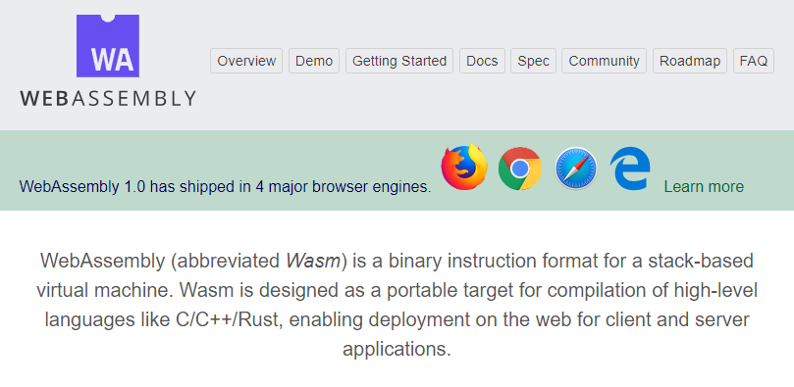
Then, in 2017 …

Slide 20
Wasm is Binary, this is a textual representation
(module
(type $t0 (func))
(type $t1 (func (result i32)))
(func $__wasm_call_ctors (type $t0))
(func $computePrimesWasm (export "computePrimesWasm") (type $t1) (result i32)
(local $l0 i32) (local $l1 i32) (local $l2 i32) (local $l3 i32) (local $l4 i32)
i32.const 1
set_local $l0
i32.const 2
set_local $l1
loop $L0
get_local $l0
set_local $l2
block $B1
block $B2
loop $L3
get_local $l2
i32.const 2
i32.lt_s
br_if $B2
get_local $l1
get_local $l2
i32.rem_s
set_local $l3
get_local $l2
i32.const -1
i32.add
set_local $l2
get_local $l3
br_if $L3
end
get_local $l0
i32.const 1
i32.add
set_local $l0
get_local $l1
i32.const 1
i32.add
tee_local $l1
i32.const 50000
i32.ne
br_if $L0
br $B1
end
get_local $l1
set_local $l4
get_local $l0
i32.const 1
i32.add
set_local $l0
get_local $l1
i32.const 1
i32.add
tee_local $l1
i32.const 50000
i32.ne
br_if $L0
end
end
get_local $l4)
(table $T0 1 1 anyfunc)
(memory $memory (export "memory") 2)
(global $g0 (mut i32) (i32.const 66560))
(global $__heap_base (export "__heap_base") i32 (i32.const 66560))
(global $__data_end (export "__data_end") i32 (i32.const 1024)))

Slide 21
Demo: Wasm and Performance

Slide 22
…and also in 2017…
.NET

Slide 23
Wait. Why use .NET for browser apps?
Modern languages (C#)
.NET ecosystem
Performance
Full-stack
Tools
Stable & mature

Slide 24
“Blazor” experimental project
Full-stack web development with .NET via WebAssembly
No plugin or code transpilation
Works in all modern browsers including mobile browsers
Browser + Razor = Blazor!

Slide 25
Blazor
https://blazor.net

Slide 26
Get started

Slide 28


Slide 29


Slide 30
Blazor

Slide 31
Blazor

Slide 32







Pros
> Thin client
> Full runtime
> Simpler arch.
Cons
> No offline
> Latency
> Server resources
File View Edit
https://...
https://...
DOM
DOM
macOS
1. Client-side
2. Server-side
(Razor Components)
3. Desktop app
(Electron)

Slide 33
DEPENDENCY INJECTION
SERVER-SIDE RENDERING
COMPONENT MODEL
FORMS & VALIDATION
DEBUGGING
PUBLISHING
Blazor
ROUTING
LAYOUTS
UNIT TESTING
AUTO REBUILD
ASSEMBLY TRIMMING
JAVASCRIPT INTEROP
INTELLISENSE & TOOLING
COMPONENT PACKAGES

Slide 34
Reusable Components

Slide 35
.NET Standard libraries and JS/.NET interop

Slide 36
Implement Code-behind

Slide 37
Using the MVVM Pattern

Slide 38
Debugging

Slide 39

https://blog.jeremylikness.com/
@JeremyLikness
Jeremy.Likness@microsoft.com
💻 Demo source code: https://jlik.me/fli
▶ Get Started with Blazor: https://jlik.me/flf
👋🏻 Introduction/Overview of Blazor: https://jlik.me/flg
🔪 Intro to Blazor Components: https://jlik.me/flh

